Slide 1
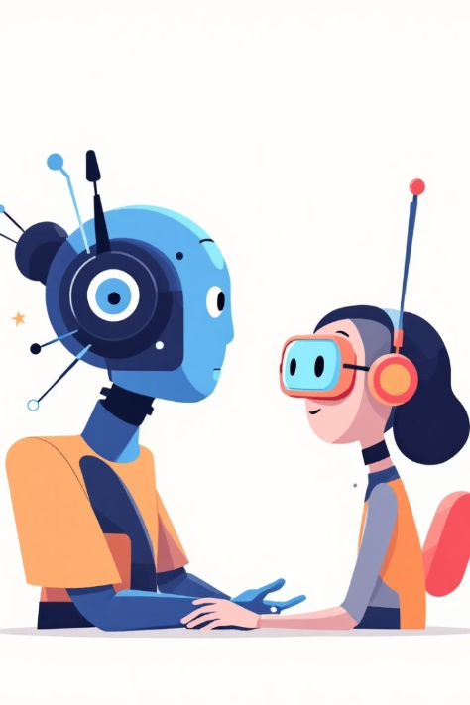
FOUNDATIONAL NLP
Pretraining and Finetuning
Presented by: Felix Tetteh Akwerh and Adwoa Bremang

Slide 2





Table of context
Pre-Training Overview
Steps in Pre-Training
Word Embeddings
Word Embeddings Techniques
Applications of NLP

Slide 3
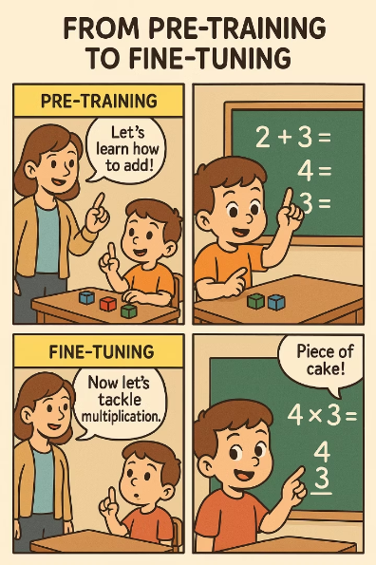
Pre-Training Overview
Definition
Purpose
Initial phase training on large, diverse datasets.
Develops general representations for later specialization.
Output
A generalist model saved for fine-tuning.

Slide 4
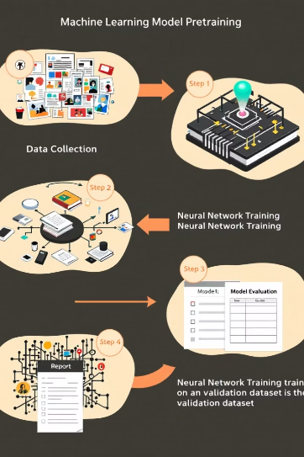
Steps in Pre-Training
Training Data
Use vast, diverse datasets for comprehensive learning.
Tokenization
Transform input data into tokens manageable by the model.
Neural Network Training
Adjust weights to capture patterns and relationships.
Model Saving
Store pretrained model for downstream task adaptation.

Slide 5
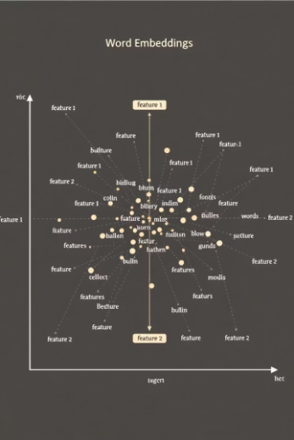
Word Embeddings
Word Vectors
Semantic and Syntactic
Provides a dense, continuous and compact representation of words.
attributes,
Linguistic relationships
between words.

Slide 6
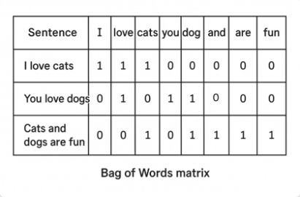
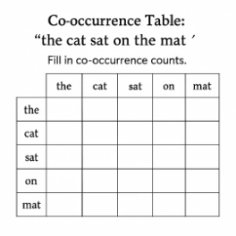
Word Embeddings Techniques
Count Based Techniques
These use the frequency of words appearing together in a corpus to represent words as vectors.
Co-occurrence Based / Static Embedding Techniques
Example: Bag of Words counts occurrences of words without context.
Static embeddings capture word meanings using co-occurrence statistics but do not change
with context.
Example: Word2Vec, GloVe generate fixed vectors for words.
TF-IDF (Term Frequency - Inverse Document Frequency)
A weighting scheme emphasizing important words by balancing frequency against commonality across documents.
Formula: IDF = log(Total number of sentences / Number of sentences with the word)

Slide 7
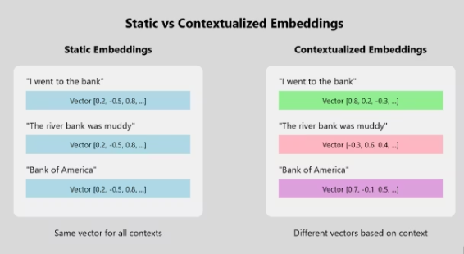
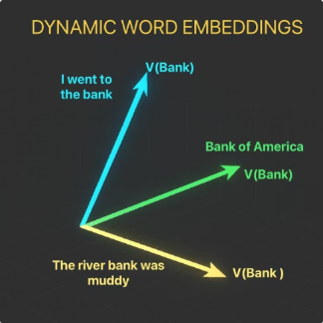
Word Embeddings Techniques
Contextualized / Dynamic Representation Techniques
Contextualized or dynamic representation techniques generates word or entity representations by considering the specific context in which they appear, rather than assigning a fixed
vector to each word.
Example: BERT and ELMo

Slide 8

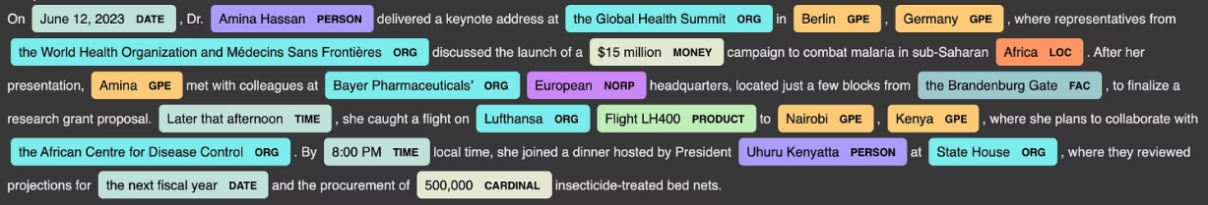
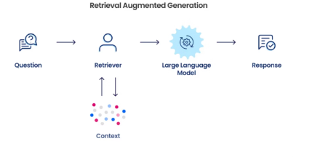
APPLICATIONS OF NLP
In this tutorial we will focus on
1. Name Entity Recognition
2. Retrieval Augmented Generation
Source Image: https://snorkel.ai/which-is-better-retrieval-augmentation-rag-or-fine-tuning-both/

Slide 9

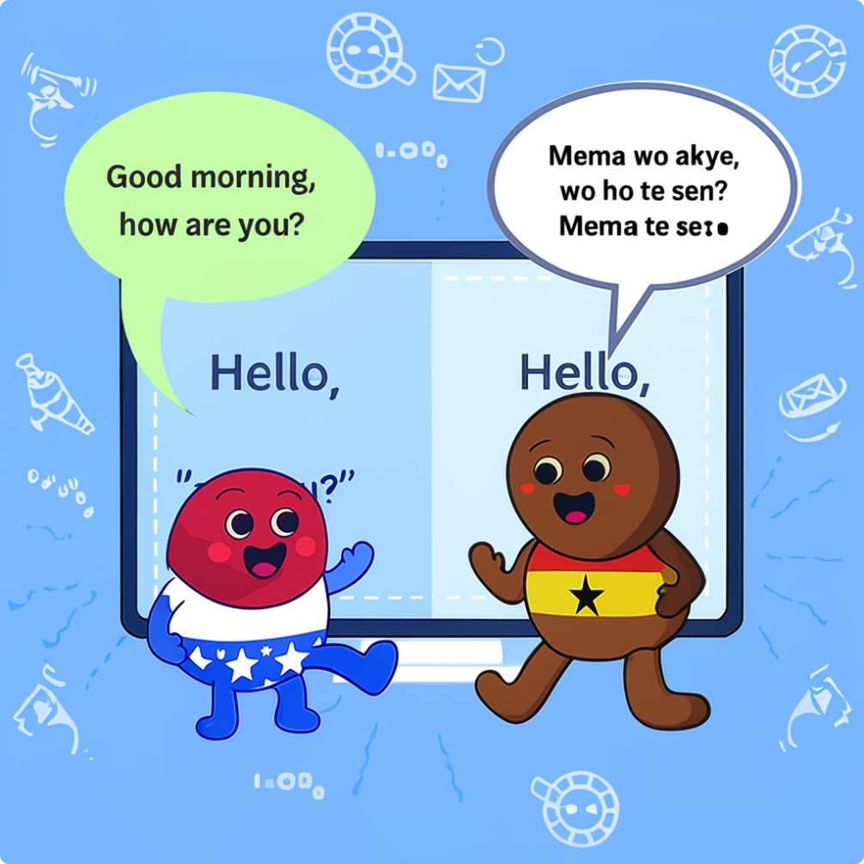

3. Neural Machine Translation
Neural networks power fluent and context-aware translations.

Slide 10
References
ChatGPT. (2025, May 25). Image Generation in slides. OpenAI. https://chat.openai.com/chat
https://arxiv.org/abs/1901.09069
https://youtu.be/wjZofJX0v4M?si=o9GxjKzHFM-VMW5R

